Slide 1
ETHICAL AND SOCIAL ISSUES IN INFORMATION SYSTEMS
Understanding Ethical and Social Issues Related to Systems
Ethics are the principles of right and wrong, individuals acting as free moral agents, use to make choices to guide their behavior.
Information systems raise new ethical questions for both individuals and societies because they create opportunities for intense social change.
Ethical, social, and political issues are closely linked. Introduction of new technology has a ripple effect in the current equilibrium, creating new ethical, social, and political issues that must be dealt with on individual, social, and political levels.

Slide 2
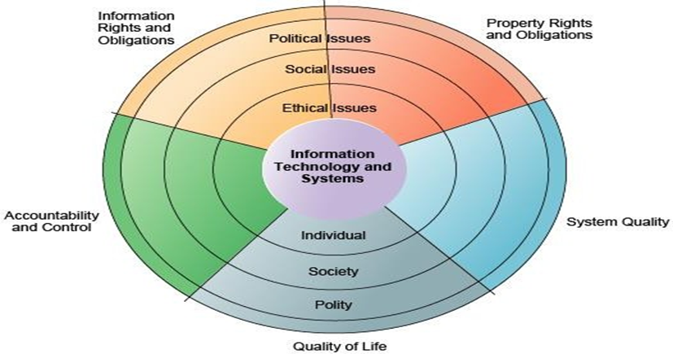
FIGURE 4-1 THE RELATIONSHIP BETWEEN ETHICAL, SOCIAL, AND POLITICAL ISSUES IN AN INFORMATION SOCIETY

Slide 3
The introduction of new information technology has a ripple effect, raising new ethical, social, and political issues that must be dealt with on the individual, social, and political levels. These issues have five moral dimensions: information rights and obligations, property rights and obligations, system quality, quality of life, and accountability and control.
There are five main moral dimensions that tie together ethical, social, and political issues in an information society. These moral dimensions are:

Slide 4
Information rights and obligations. What information rights do individuals and organizations possess with respect to themselves? What can they protect?
Property rights and obligations. How will traditional intellectual property rights be protected in a digital society in which tracing and accounting for ownership are difficult and ignoring such property rights is so easy?
Accountability and control. Who can and will be held accountable and liable for the harm done to individual and collective information and property rights?
System quality. What standards of data and system quality should we demand to protect individual rights and the safety of society?
Quality of Life. What values should be preserved in an information- and knowledge-based society?

Slide 5
Four key technology trends have heightened the ethical stresses on existing social arrangements and laws.
Computing power has doubled every 18 months allowing growing numbers of organizations to use information systems in their core business processes. This growing dependence on critical systems increases vulnerability to system errors and poor data quality.
Advances in data storage techniques have enabled for the multiplying databases on individuals maintained by private and public organizations - making the violation of individual privacy both cheap and effective.
Advances in data analysis techniques enable companies and government agencies use profiling to determine detailed information about individual's habits and tastes and create dossiers of detailed information. Nonobvious relationship awareness (NORA) is a new data analysis technology that can take data about people from many sources and correlate relationships to find hidden connections to identify potential criminals and terrorists. Figure 4-2

Slide 6
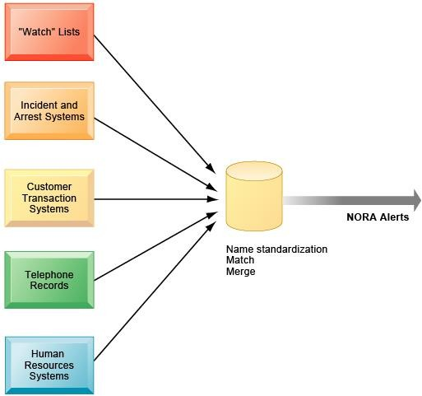
FIGURE 4-2 NONOBVIOUS RELATIONSHIP AWARENESS (NORA)

Slide 7
NORA technology can take information about people from disparate sources and find obscure, nonobvious relationships. It might discover, for example, that an applicant for a job at a casino shares a telephone number with a known criminal and issue an alert to the hiring manager.
4. Advances in networking reduce the costs of moving and accessing data, permitting privacy invasions on a vast scale.

Slide 8
Ethics in an Information Society
Ethical decisions draw on the concepts of:
Responsibility: Accepting the potential costs, duties, and obligations of one's decisions accountability
Accountability: A feature of systems and social institutions, accountability means that mechanisms are in place to determine who took responsible action and who is responsible for an action.
Liability: Refers to the existence of laws that permit individuals to recover the damages done to them by other actors, systems, or organizations
Due process: Requires that laws are known and understood by all, and that individuals can appeal to higher authorities to ensure laws were properly applied
A five-step process can help analyze ethical issues:
Identifying the facts,
Defining the conflict or dilemma and identifying the values involved,
Identifying the stakeholders,
Identifying options that can be taken, and
Identifying potential consequences of actions.

Slide 9
Six traditional principles can be used to help forming an ethical decision:
The Golden Rule: Do unto others as you would have them do unto you.
Immanuel Kant's Categorical Imperative: If an action is not right for everyone to take, it is not right for anyone.
Descartes' rule of change: If an action cannot be taken repeatedly, it should not be taken at any time.
The Utilitarian Principle: Take the action that achieves the higher or greater value.
The Risk Aversion Principle: Take the action that produces the least harm or least cost.
The ethical "no free lunch" rule: All tangible objects are assumed owned by someone else unless specifically declared otherwise.
Groups of professionals, such as the IEEE, take on special rights and obligations because of their claims to knowledge and wisdom. Professional codes of conduct are promulgated by associations of professionals to take responsibility for the partial regulation of their professions.
Ethical dilemmas are created when one set of interests is pitted against another, for example when the rights of a company to prevent its workforce from wasting company resources are pitted against the rights of employees to privacy.

Slide 10
The Moral Dimensions of Information Systems
There are ethical, social, and political levels of analysis for each of the five moral dimensions of information systems.
Privacy is the claim of individuals to be left alone, free from surveillance or interference from other individuals or organizations, including the state.
Information technology and systems threaten individual claims to privacy by making the invasion of privacy cheap, profitable, and effective. The claim to privacy is protected in the Kenyan, U.S., Canadian, and German constitutions in a variety of different ways, and in other countries through various statutes.
The Kenya data protection act of 2019 regulates government and other organization on collection use, and disclosure and storage of information.
American and European privacy law is based on the principles of Fair Information Practices (FIP) set forth in 1973 to govern the collection, and use of information about individuals. This report states that an individual has an interest in the information gathered about him or her and the record may not be used to support other activities without the individual's consent.

Slide 11
The Gramm-Leach-Bliley Act of 1999, requires financial institutions to disclose their policies for protecting the privacy of nonpublic personal information and to allow customers to opt out of information-sharing arrangements with nonaffiliated third parties.
The Health Insurance Portability and Accountability Act of 1996 (HIPAA), gives patients access to their personal medical records maintained by healthcare providers and the right to authorize how protected information about themselves can be used or disclosed, and limits the disclosure of personal information about patients to the minimum amount necessary to achieve a given purpose.
European privacy protection is much more stringent than in the United States. The European Directive on Data Protection requires companies to inform people when they collect information about them and to disclose how it will be stored and used. Customers must provide their informed consent (consent given with knowledge of all the facts needed to make a rational decision) before any company can legally use data about them.

Slide 12
EU member nations cannot transfer personal data to countries that don't have similar privacy protection regulations. To work with Europeans privacy laws, the U.S. Department of Commerce developed a safe harbor framework for U.S. firms.
A safe harbor is a private, self-regulating policy and enforcement mechanism that meets the objectives of government regulators and legislation but does not involve government regulation or enforcement. U.S. firms must be certified by public accounting firms to be "safe harbor" for personal data on Europeans, and this certification is recognized (but not enforced) by the Department of Commerce.

Slide 13
The Internet poses new challenges to the protection of individual privacy because information can easily be monitored, captured, and stored as it passes through its network of computer systems.
Companies can record a user's on-line activities, such as what files were accessed or which Web sites were visited. Web sites can learn the identity of their visitors if the visitors voluntarily register at the site or they can capture information about visitors without their knowledge using "cookie" technology. Cookies are tiny files deposited on a computer hard drive when a user visits certain Web sites that track visits to the Web site. Some companies use Web bugs, which are tiny graphic files embedded into e-mail messages and Web pages to monitor who is reading the e-mail message or Web page. Figure 4-3 BELOW HOW COOKIES IDENTIFY WEB VISITORS
Cookies are written by a Web site on a visitor’s hard drive. When the visitor returns to that Web site, the Web server requests the ID number from the cookie and uses it to access the data stored by that server on that visitor. The Web site can then use these data to display personalized information.

Slide 14
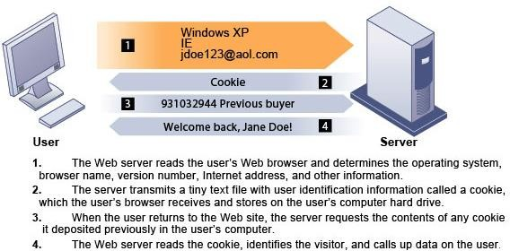
Figure 4-3 BELOW HOW COOKIES IDENTIFY WEB VISITORS

Slide 15
Most Internet businesses do little to protect their customers' privacy other than the publication of privacy statements. Some e-commerce sites add opt-out selection boxes to their privacy statement, which, when accepted by a visitor, permit the collection of personal information.
Privacy advocates promote the wider use of an opt-in model of informed consent in which businesses are prohibited from collecting information unless specifically allowed by the consumer.
Spyware is small applications that can secretly install itself on an Internet user's computer by piggybacking on larger applications. Once installed, the spyware calls out to Web sites to send banner ads and other unsolicited material to the user, and it can also report the user's movements on the Internet to other computers.
In addition to legislation, new technologies are available to protect user privacy during interactions with Web sites, including encrypting email, anonymizing Web surfing, preventing cookies, and eliminating spyware. The Platform for Privacy Preferences (P3P) is a standard for communicating a Web site's privacy policy to Internet users to help them select the level of privacy they wish to maintain when interacting with the Web site.

Slide 16
INTELLECTUAL PROPERTY RIGHTS
Contemporary information systems have severely challenged existing law and social practices protecting intellectual property, which is the intangible property created by individuals or corporations that is subject to protections under trade secret, copyright, and patent law.
A trade secret is an intellectual work product used for a business practice that can be classified as belonging to that business, provided it is not based on information in the public domain. Trade secret law protects the actual ideas in a work product, not only their manifestation. However, in the case of computer software, it is difficult to prevent the ideas in the work from falling into the public domain when the software is widely distributed.
Copyright is a statutory grant which protects creators of intellectual property against copying by others for the life of the author plus an additional 70 years, or for a total of 95 years for corporate copyrights. Copyright protects against copying of entire software programs or their parts. However, the ideas behind a work are not protected, only their manifestation in a work. A competitor can build new software that follows the same concepts without infringing on a copyright. (Kenya-KECOBO)
A patent grants the owner an exclusive monopoly on the ideas behind the invention for 20 years. The key concepts in patent law are originality, novelty, and invention. Patent protection is that it grants a monopoly on the underlying concepts and ideas of software. The difficulty is passing stringent criteria for novelty and invention. (Kenya-KIPI)

Slide 17
Digital media and software can be so easily copied, altered, or transmitted, that it is difficult to protect with existing intellectual property safeguards. Illegal copying of software and music and video files is rampant worldwide. While protecting against copying of software program code, copyright protection can't prevent another person from using the underlying ideas behind a piece of software and developing software that follows the same concepts.
Very little software has received patent protection, which does protect the underlying ideas behind software, because the software must pass very stringent criteria concerning the originality and novelty of those ideas. The Internet makes it even easier to copy intellectual property and transmit it freely around the world.
Mechanisms are being developed to sell and distribute books, articles, and other intellectual property legally on the Internet, and the Digital Millennium Copyright Act (DMCA) of 1998 is providing some copyright protection. The DMCA implemented a World Intellectual Property Organization Treaty that makes it illegal to circumvent technology-based protections of copyrighted materials.

Slide 18
New information technologies are also challenging existing liability law and social practices for holding individuals and institutions accountable. A producer of computer software that is part of a machine that causes damage can be held liable for damages. However producers of computer software products that are treated like books are not yet considered liable for the harm the software causes.
Are individuals and organizations that create, produce and sell information systems software and services morally responsible for the consequences of their use? What is an acceptable level of system quality and reliability when most software can never be 100% error free? Both of these questions remain open issues.
The negative social costs of introducing new information technologies are beginning to mount. By creating more efficient organizations, information systems threaten to eliminate many management and clerical jobs. Many organizations have heightened their vulnerability to natural disasters, power outages, computer crime, computer abuse, and computer viruses because they are so dependent on computers.
Information systems enable a "do anything anywhere" work environment that erodes the traditional boundaries between work and family life, lessening the time individuals can devote to their families and personal lives. Essential public organizations are ever more dependent on vulnerable digital systems.

Slide 19
Computer crime
Computer crime (the commission of illegal acts through the use of a computer against a computer system) and
computer abuse (the commission of acts involving a computer that may not be illegal but are considered unethical) are primarily committed by people inside the organization. Spam is unrequested junk e-mail sent to thousands of Internet users.

Slide 20
Redesigning business processes could potentially cause millions of middle level managers and clerical workers to lose their jobs.
Information technology may help intensify the cleavage between rich and poor, causing a digital divide in which information, knowledge, and access to computers are inequitably distributed among social classes.
Finally, computers may be responsible for the mounting incidence of repetitive stress injury (RSI). The single largest source of RSI is computer keyboards. Other occupational illnesses related to computer use include computer vision syndrome (CVS) (any eyestrain condition related to computer display screen use) and technostress, stress induced by computer use. Technostress symptoms include aggravation, hostility toward humans, impatience, and fatigue.

